Slide 1

Infoliteracy@adistance
Creating Opportunities to Reach
(Instruct) Distance Students

Slide 2

I. Introduction
We began with a controversial topic and a critical question.
Research indicates that low- and non-use of college and university libraries exists.
What do contemporary trends mean for the future of college education in America, particularly for the place of academic libraries and roles of professional librarians?

Slide 3
Today’s Agenda
Mirah Dow
Introduction: How our study came about
Abdullahi Musa
Problem and theoretical framework
Sandy Valenti
Survey and interview methodology
Distance students and their particular challenges
Padma Polepeddi
Our conclusions and action steps for
improving information literacy and
search skills
Terri Summey

Slide 4
II. Problem & Theoretical Framework
Empirical evidence links the use of college library resources to achieving academic excellence.
  Unfortunately, studies indicate that low and non-use of the services of university librarians by students is a major problem.
Bates’ (2002) model of information seeking and searching was adopted as a theoretical
framework to explore this problem.

Slide 5
Marcia Bates (2002)
Bates introduces four modes of information seeking behavior:
directed and undirected; and
active and passive.

Slide 6
Bates’ (2002) Basic Premises
The natural propensity of humans is to
acquire information passively through elaborate social networks.
have difficulties due to low information literacy skills.
lack supports during online seeking.
adopt the principle of least effort in seeking and searching for information.

Slide 7
III. Methodology
Mixed methods data collection:
All students enrolled in fully online courses were sent a Zoomerang electronic survey
Follow up interviews were conducted, using a semi-structured interview process

Slide 8
Respondents - Zoomerang
1,477 Graduate Students were e-mailed a survey form

Slide 9
Semi-Structured Interviews
13 students were interviewed
  Adobe Connect Pro was used to conduct and record the interviews for transcription in many cases

Slide 10
Coding
Category | Number by Category | Percentage by Category | Example Response(s) Category
Searching (active seeking M. Bates) Solo Searching – I don’t need assistance. Assisted Searching – I received assistance from someone. | 23 8 |  | 1.Online links/Google Scholar; library site sources; other resources 2. I search Google Scholar. I get information from my instructor. I use WAW library website. I use the online index system. I check through encyclopedia sites and other resources. 3. Easier to get what I was looking for without assistance. I prefer to work independently.

Slide 11
IV. Findings: Low and non-use
Students:
  have the “know-how” and use numerous computer technologies.
    rarely attend library orientation or ask a librarian for assistance.
    ask their professors, not usually librarians, for assistance.
  find sources by accidently (passively)
  encountering Internet-based pages that
  pique their interest.

Slide 12
Findings: Low and non-use
Students experience barriers, or challenges, to accessing information for academic assignments:
  lack of time
  lack of content expertise
  lack of confidence
  lack of technical expertise
This includes difficulty evaluating best information, search term confusion, and bad links or outdated information.

Slide 13
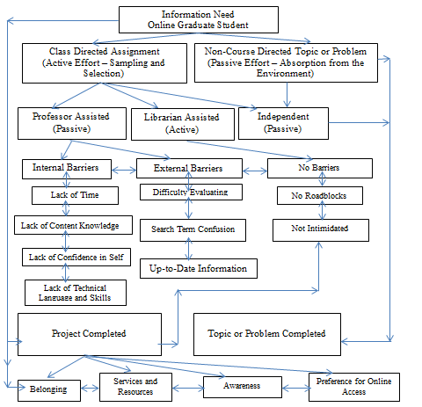
Dow Research Team Online Graduate Student Information Seeking Model

Slide 14
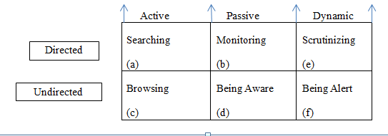
Modes of Information Seeking
(Derived from Bates)

Slide 15
V. Conclusions
Limitations exist in the study
Our view of what students know and do has changed.
  The idea of a librarian as an academic expert is not
  an ideal that students necessarily accept, so librarians must not wait for students to ask for assistance.
  Librarians must communicate through many venues and form collaborative partnerships on campus, particularly with professors.
Future research opportunities exist.

Slide 16
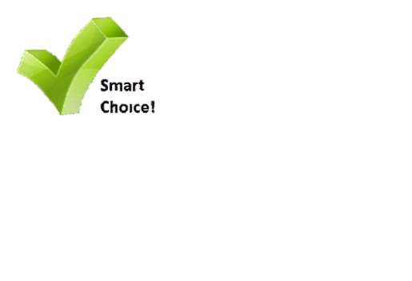
VI. Action Steps - Handout
Students
Make Smart Choices, Get it Right!
Librarians
Help Students Make Smart Choices!

Slide 17
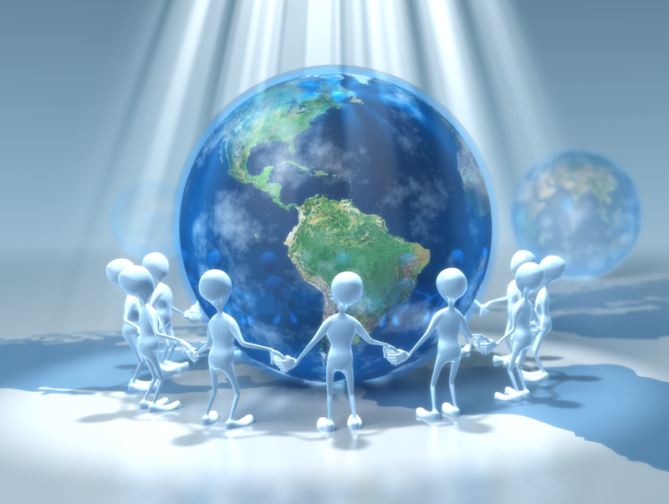
V. Questions?

