Slide 1
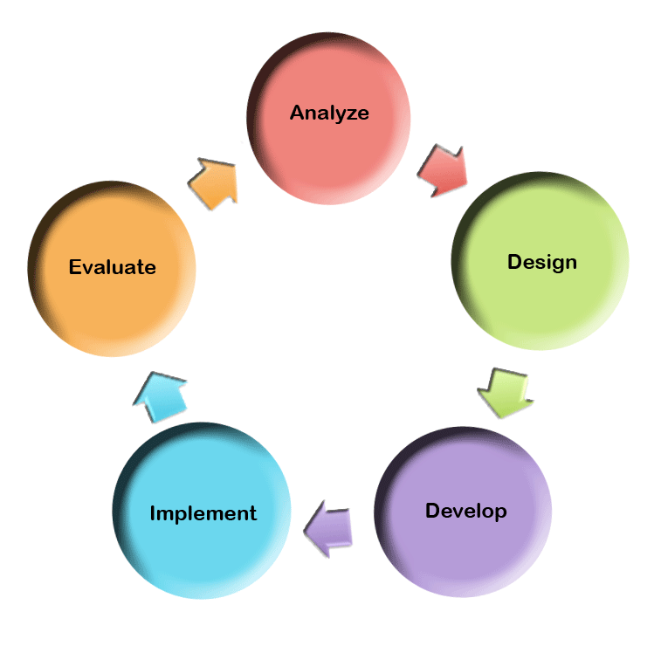
But We Don’t Have an Instructional Designer
Using the ADDIE model to create instruction

Slide 2

Anytime, Anywhere

Slide 3
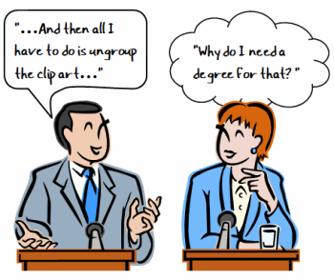

Slide 4

ADDIE?

Slide 5
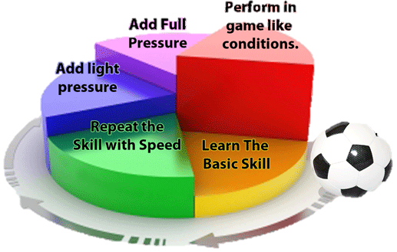
Chunking Down

Slide 6



Iterative Process

Slide 7

Subject Matter Expert

Slide 8

Proficiencies

Slide 9

Instructional Design and Libraries

Slide 10

BLAAM
Assess instructional needs and situation
Determine learning objectives
Develop an instructional plan and activities
Deliver the instruction
Measure outcomes against learning objectives

Slide 11
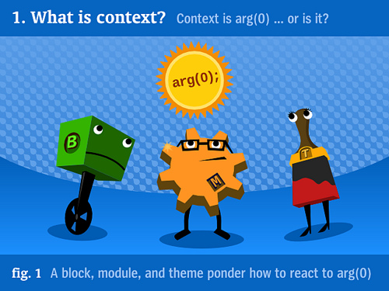

Slide 12


Slide 13


Slide 14



Slide 15


Slide 16
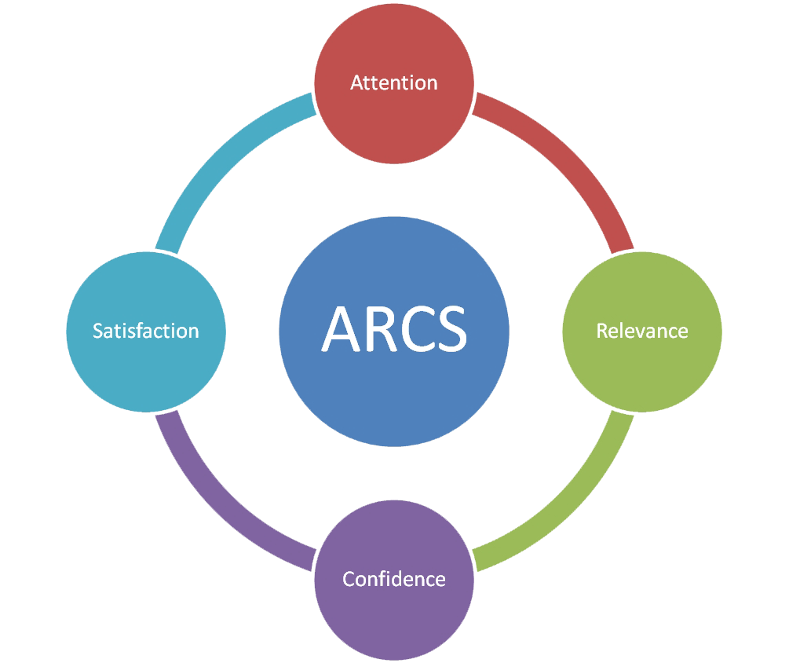
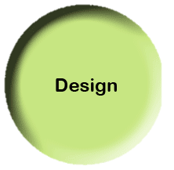

Slide 17


Slide 18
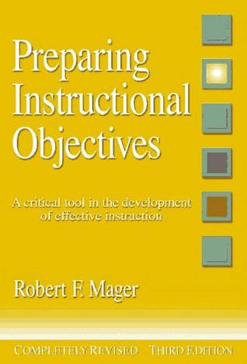

Slide 19


Slide 20


Slide 21
Remember your SME

Slide 22


Slide 23





Slide 24


Slide 25
Practice

Slide 26


Slide 27

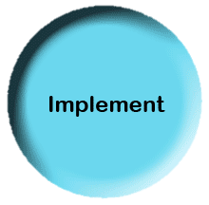

Slide 28


Slide 29


Slide 30


Slide 31
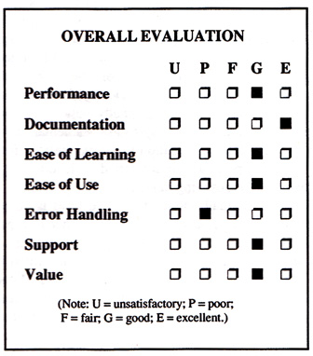
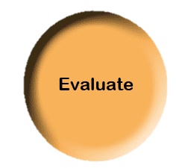

Slide 32


Slide 33


Slide 34


Slide 35




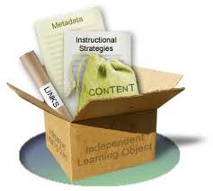
Using ISD in Libraries

Slide 36


Slide 37



Terri Summey
Univ. Libraries and Archives
Head of Public Services
tsummey@emporia.edu
Sandy Valenti
TCS
Instructional Technologist
svalenti@emporia.edu

