Slide 1
Cdc14p: A Mitotic Phosphatase
Chelsi Kaiser, Whitney Franklin, & Dr. Kim Simons

Slide 2
What is Cdc14p?
Cdc14 is a budding yeast protein phosphatase
Part of the Mitotic Exit Network (MEN Complex)

Slide 3
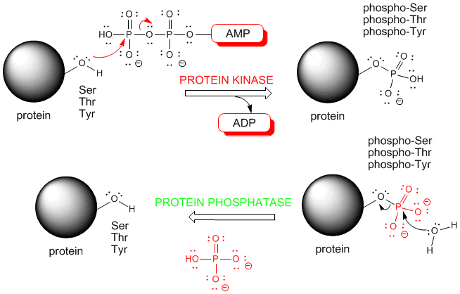
Kinase vs. Phosphatase
Kinase – adds a phosphate to a molecule from ATP
Phosphatase – removes a phosphate by adding H₂O

Slide 4
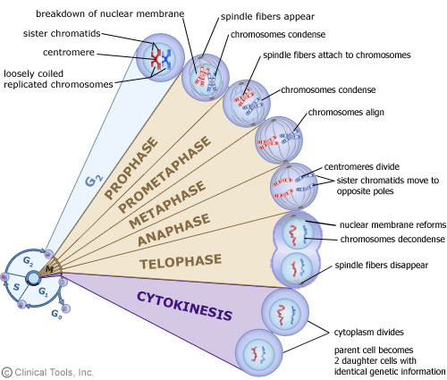
Mitosis
Process by which eukaryotic cells divide chromosomes into two identical sets of nuclei. This occurs during cell division.

Slide 5
Ultimate Goal for Research
To determine what regulates Cdc14p in the Mitotic Exit Network
What makes it turn off and on
Important in cancer research

Slide 6
Experimental Methods
Most of our research so far has been preparation for the actual study of Cdc14p
Mutagenesis- get rid of restriction enzyme site
Purified CDC14 gene
PCR
Restriction Enzyme Digest
Put in vector - pGEX
DNA Gel

Slide 7
Mutagenesis
M
M

Slide 8
CDC14 Gene

Slide 9
Gel of Digest PCR Product
M
CDC14
C pGEX
CDC14
W pGEX
8400
7240
2320
1900
1370

Slide 11
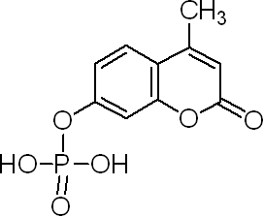
Further Experiments
Fluorescent Phosphatase Assay – MUP
Cleave phosphate and it becomes fluorescent
Track activity by measuring fluorescence

