Slide 1


Hornets, Comics, and Books! Oh My!
Using Photo Comics for Instruction, Promotion, and Participation in the Library
Kael Moffat
Graduate Teaching Assistant
kmoffat@emporia.edu
Christina Williams
Graduate Teaching Assistant
cwilli21@emporia.edu
Matt Upson
Reference and Instruction Librarian
mupson@emporia.edu
@thunderbrarian
Notes:
1
1

Slide 2
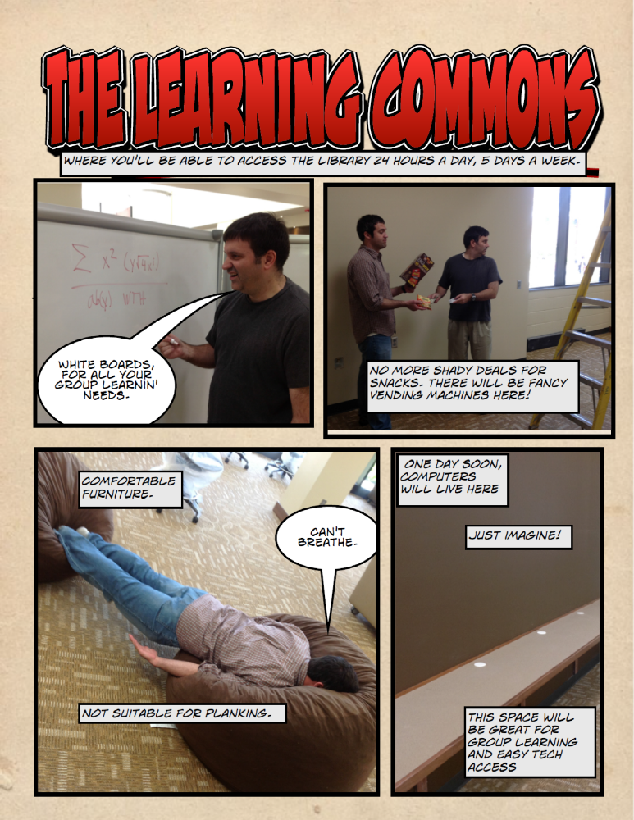
What are we talking about?
(Your own comic doesn’t have to be stupid, but it is more fun)

Slide 3
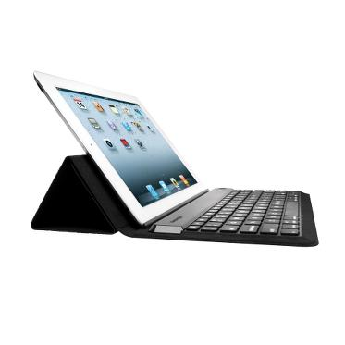

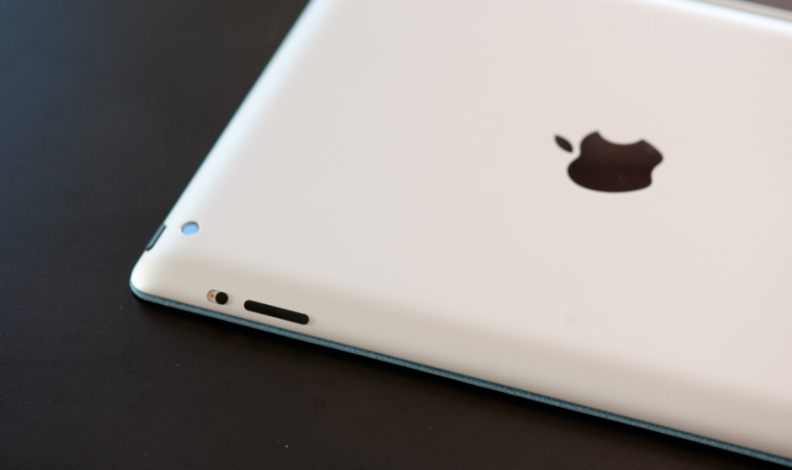


What we used…
but you don’t necessarily need
iPad (with camera)
Bluetooth keyboard
ComicLife App
  Check out plasq.com for more info
iTunes account and iPad USB cable
OR Dropbox account
Notes:
3

Slide 4
Authentic Learning
“Authentic learning involves exploring the world around us, asking questions, identifying information resources, discovering connections, examining multiple perspectives, discussing ideas, and making informed decisions that have a real impact.”
Daniel Callison & Annette Lamb (2004)
from: Authentic learning. School Library Media Activites Monthly, 21 (4). 34-39.

Slide 5
Authentic Learning
“We need to construct our own meaning of the world, using information we have gathered and were taught and our own experiences in the world.”
Jon Mueller (2005)
from: Authentic assessment in the classroom…and the library media center. Library Media Connection (April/May 2005). 14-18.

Slide 6
Authentic Learning
Relevant central tenets:
  Learning in a “real world” context—real-world situations and artifacts
  Open ended assignments—no “correct” answer
  Emphasis on social learning—mimicking the world of work
  Student have a “say” in their learning

Slide 7
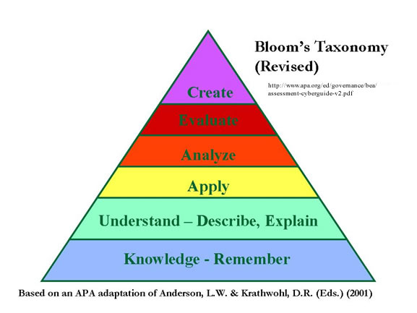
Authentic Learning
  Designed for higher-level thinking and metacognitive skills
  Implied or explicit “larger audience”
    “This audience beyond the classroom changes the problem from an ‘exercise’ to something more important, allowing students to become emotional stakeholders in the problem.”
    Audrey Rule
As cited in The four characteristics of “Authentic Learning.” (2007). Retrieved from http://www.ernweb.com/public/908.cfm#.Ukm6LD_gJjM
http://uwf.edu/cutla/images/bloom_taxonomy.jpg

Slide 8
First Year Seminar
Wanted to reconsider the Amazing Library Race
Sample questions:
  Area 3—2nd floor, reference
  Identify four ways you can ask for research help from the library reference personnel.
  What is the process for printing your papers?
  What is the room number for the Writing Center and what are the hours?
  What are the staffing days and times for the IT help desk here at the library?

Slide 9
The Safari
Revised to the ESU Library Safari
Student’s would create a visual library guide using Comic Life
Goals of revision:
  Have students co-create an artifact (group work)
  Make that artifact visually oriented (visual literacy)
  Created for each other (authentic audience)
Drawback: Not enough time in a 50-minute library session to introduce the Comic Life app and do the activity.

Slide 10
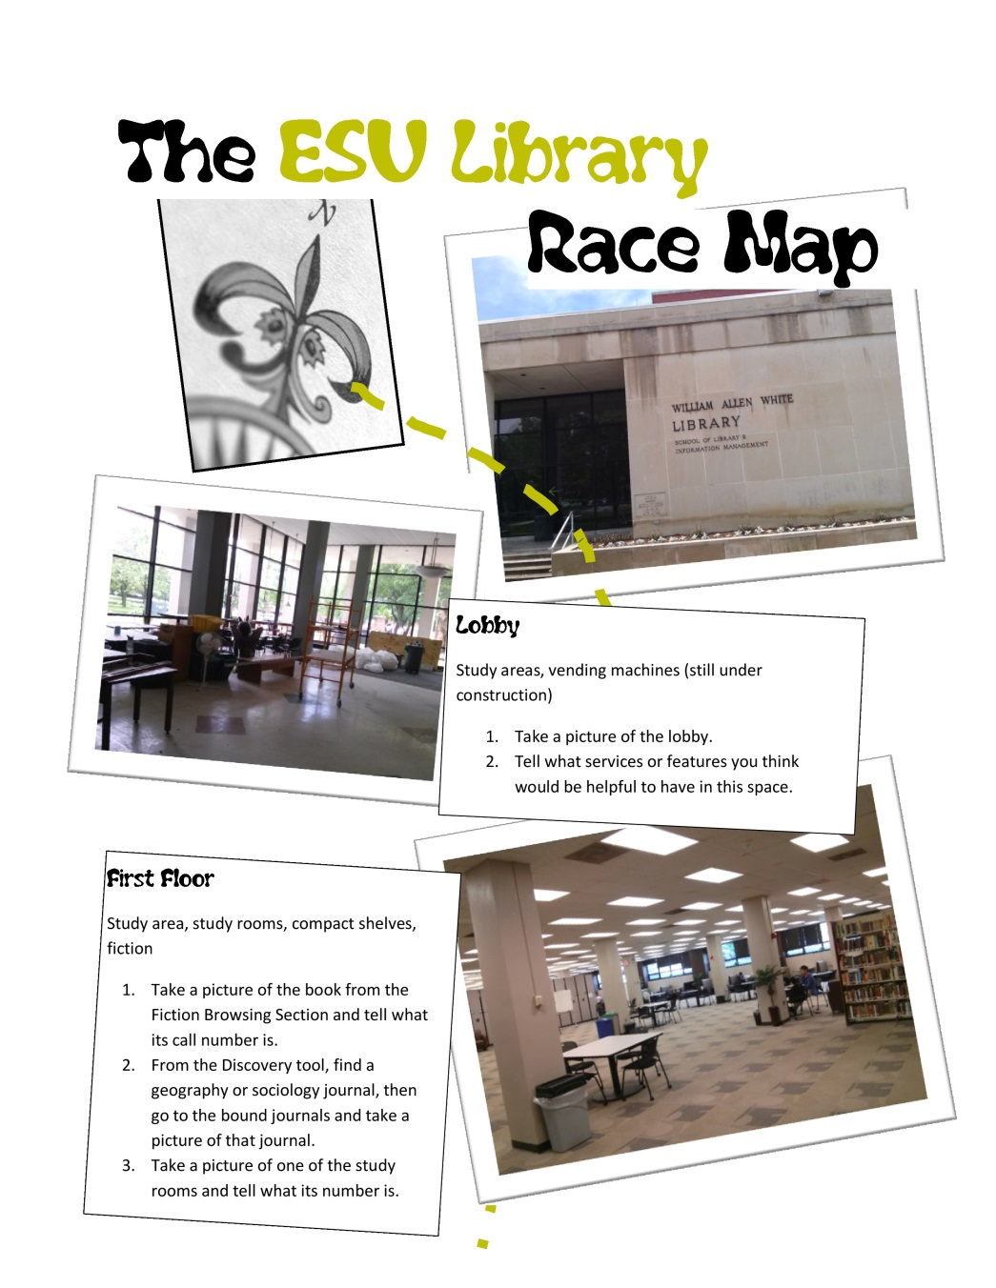
The Safari
Sample
Page

Slide 11
First Year Seminar
Asked to do library orientation for freshmen
Assumed many freshmen would have already done the library race
Modified the safari for FYS:
  Divided sessions into four groups
  Gave each group a set of tasks which should cover four comic panels
    Included brief description of the floor’s services/features

Slide 12
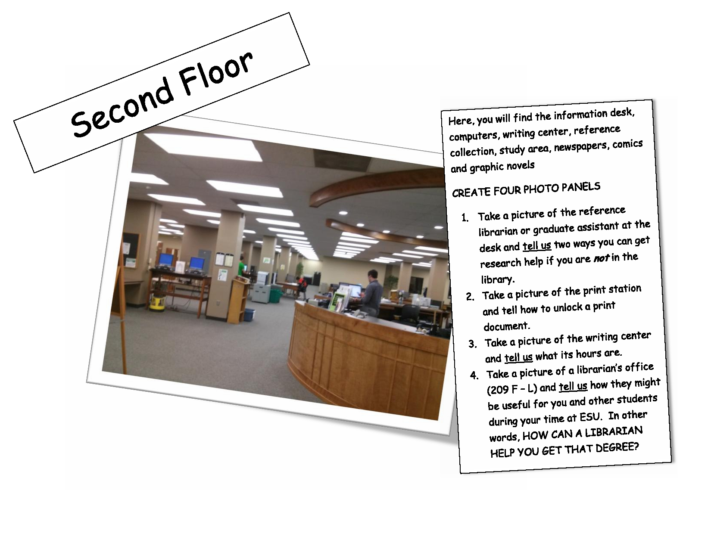
First Year Seminar Sample Page

Slide 13
First Year Seminar
  Gave students a template
  Gave about 25 minutes to complete tasks
  Encouraged students to be creative/humorous, to “own” their panels
  Wanted to have students present their pages to each other, but time did not allow
  Combined all the pages from a session into a single .pdf file and sent it to teacher to distribute to students

Slide 14
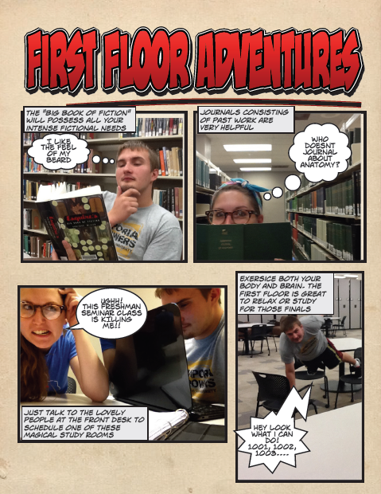
First Year Seminar
Sample Results

Slide 15
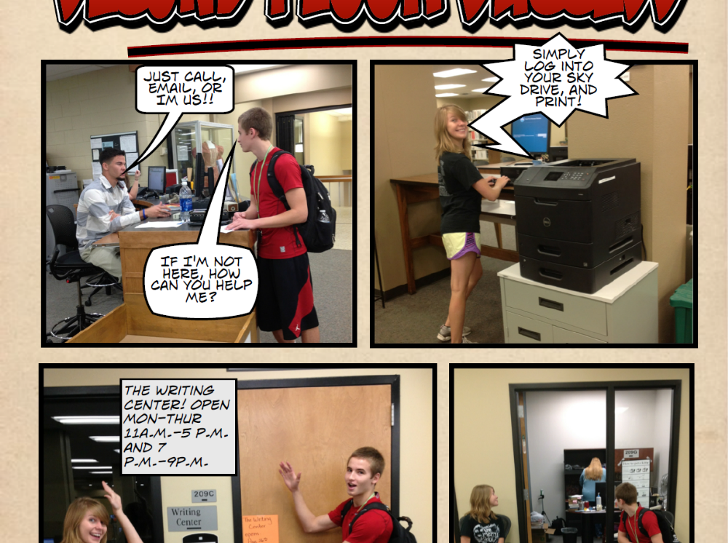
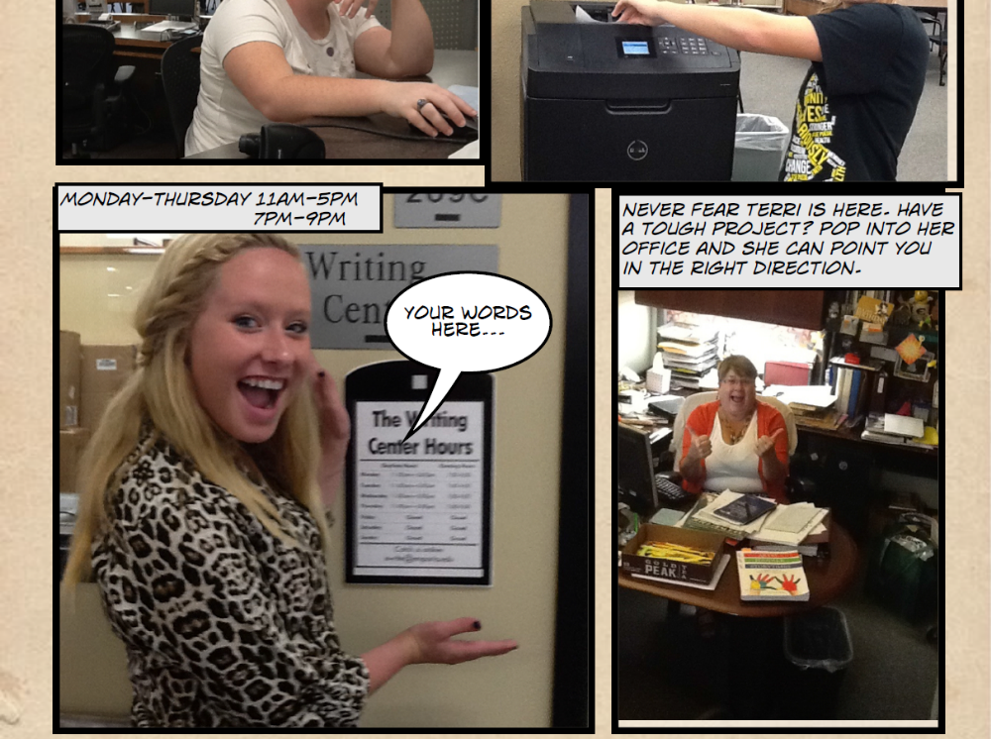
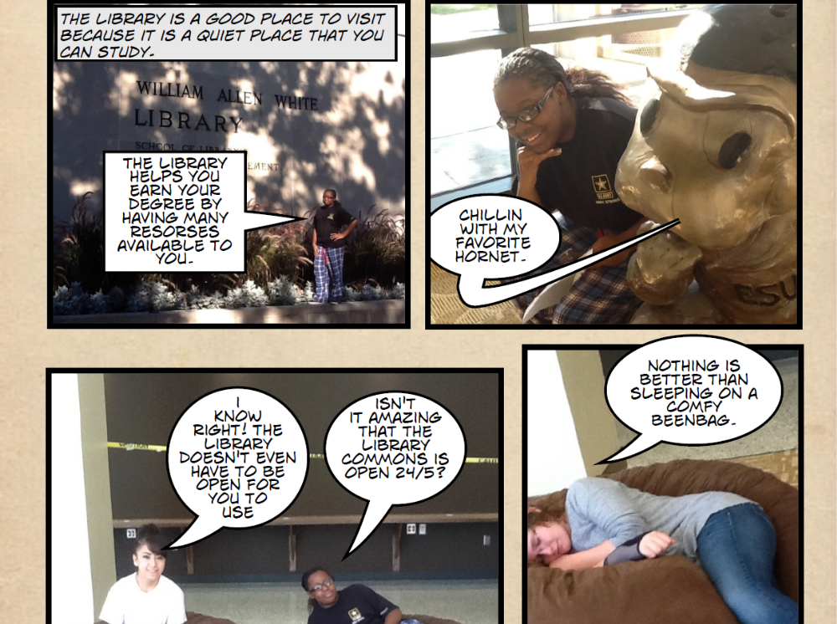

Slide 16
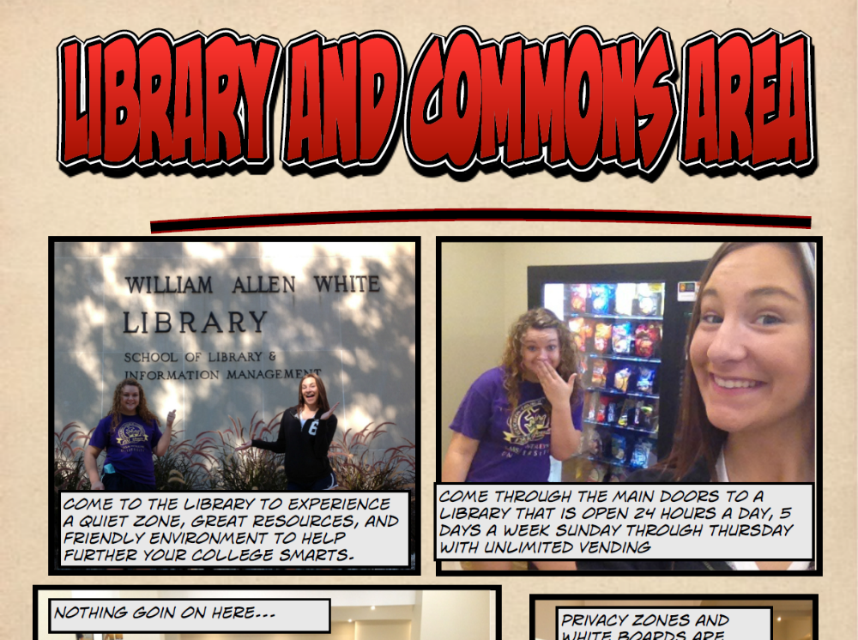
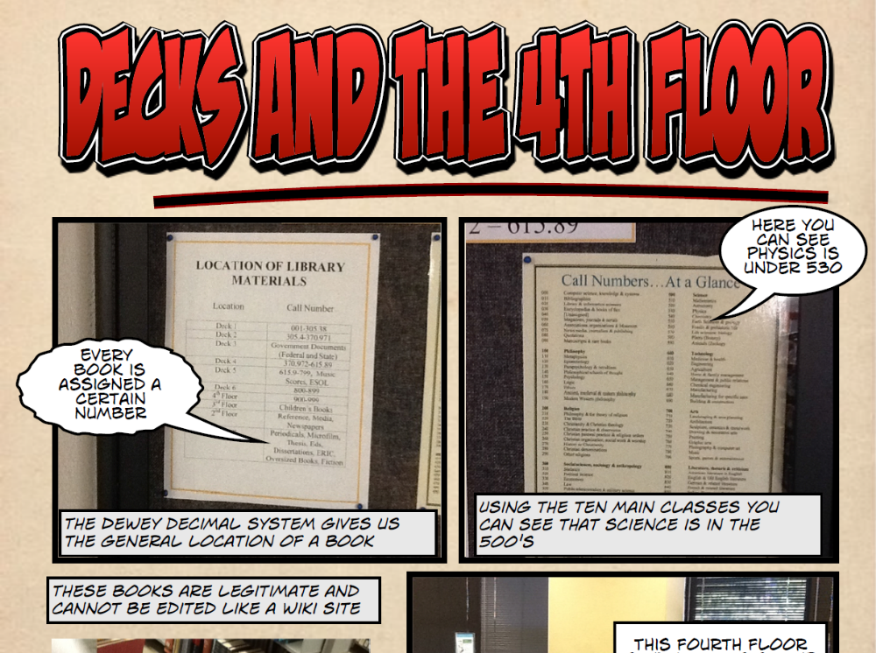

Slide 17
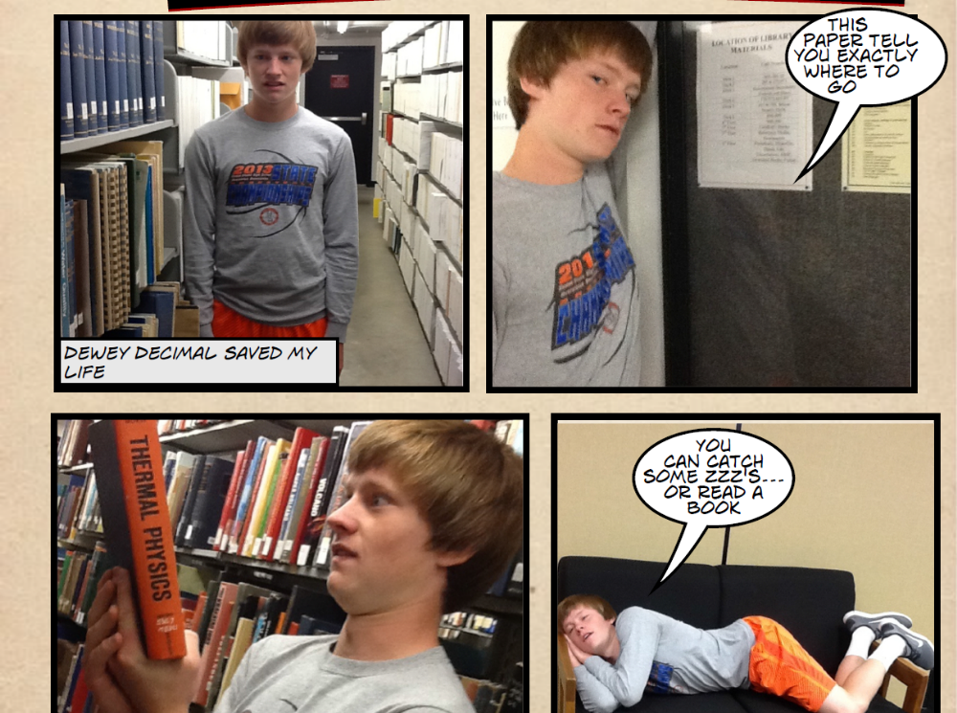

Slide 18
First Year Seminar
22
19
12
11
Reaction
(n=71)
4
1
1
1
Yes
No
Worse
37
7
31
9

Slide 19
First Year Seminar
Authentic learning:
  Believable, “real world” artifact
  Audience of peers
  Connections to “real world” experience (collaboration)
  Higher level thinking

Slide 20
Extensions
School libraries:
  Class orientation
  New employee/student proctor orientation
  Faculty/staff orientation
Public libraries:
  New employee/volunteer orientation
  Summer/vacation programming

Slide 21
Extensions
Make your OWN photo comic!
  Use it to market your library and act as a guide to your spaces and services.

Slide 22
For more detailed information on other assignments using the app and relevant ACRL and AASL standards, please visit the Kansas Library Conference Handouts page:
http://bit.ly/16grUsp
For a copy of the introduction script and the tasks themselves, please see:
http://slidesha.re/18qVj7f
Notes:
22

