Slide 1
Guide Your Students with LibGuides!
Cynthia Akers
ESU eLearning Institute
May 26, 2010

Slide 2
What is a “LibGuide”?
A software program subscribed to by the Libraries and Archives
Goes far beyond the traditional print “pathfinders”/bibliographies/lists of library resources
Great potential for collaboration among faculty, and interactive learning for students

Slide 3
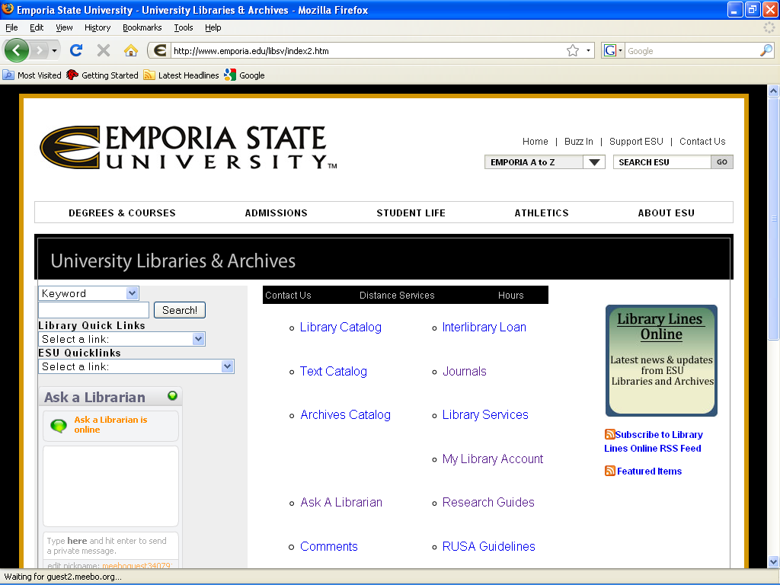
Click here to view all our LibGuides.

Slide 4
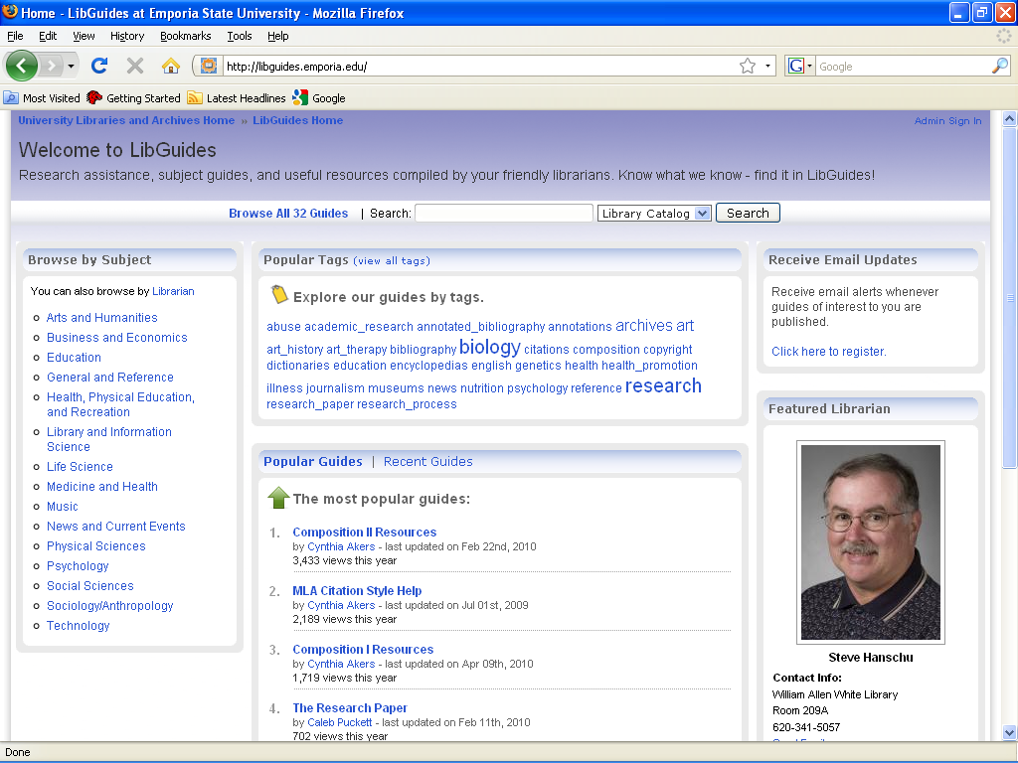

Slide 5
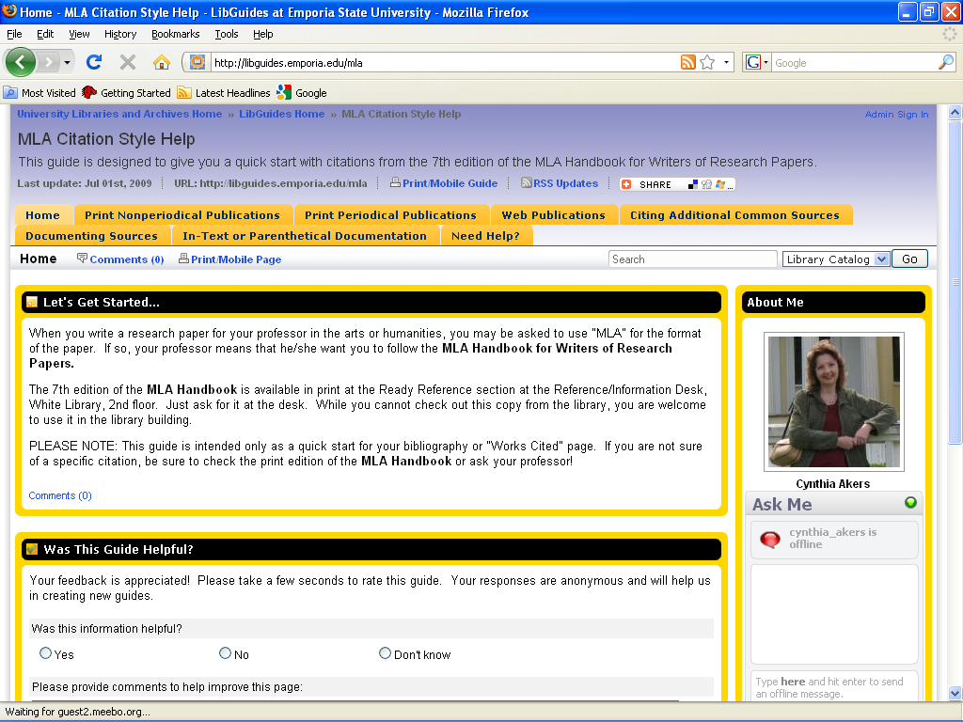

Slide 6
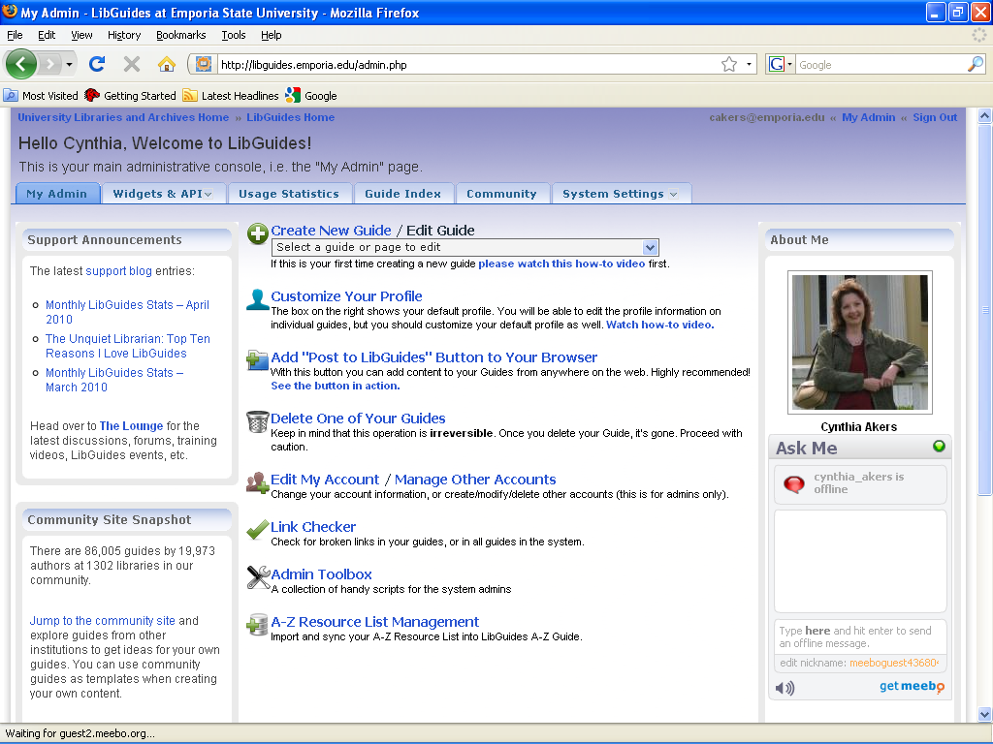

Slide 7
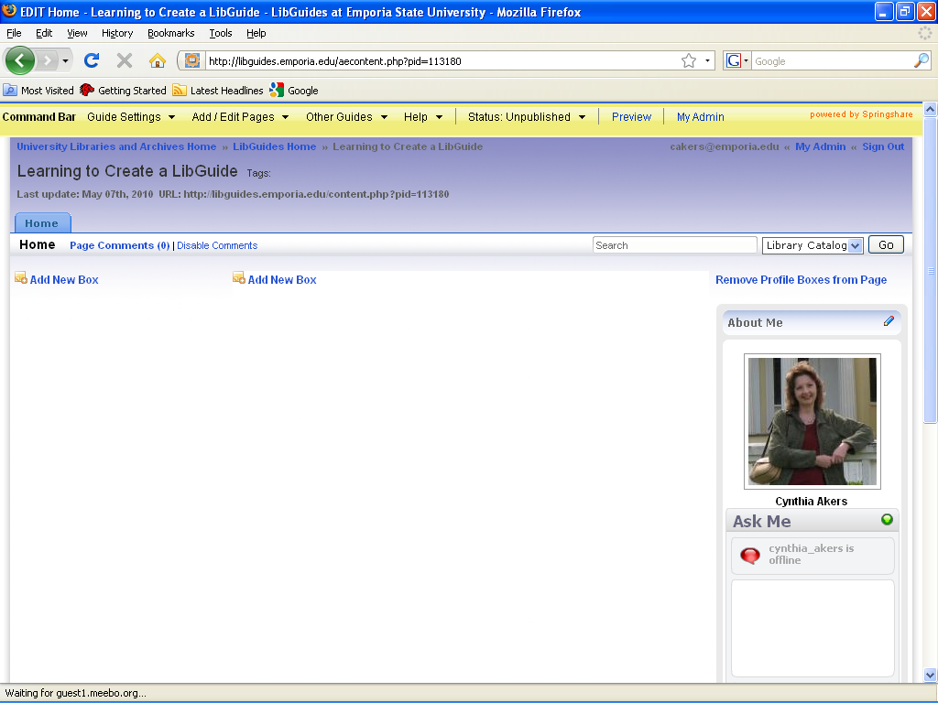

Slide 8
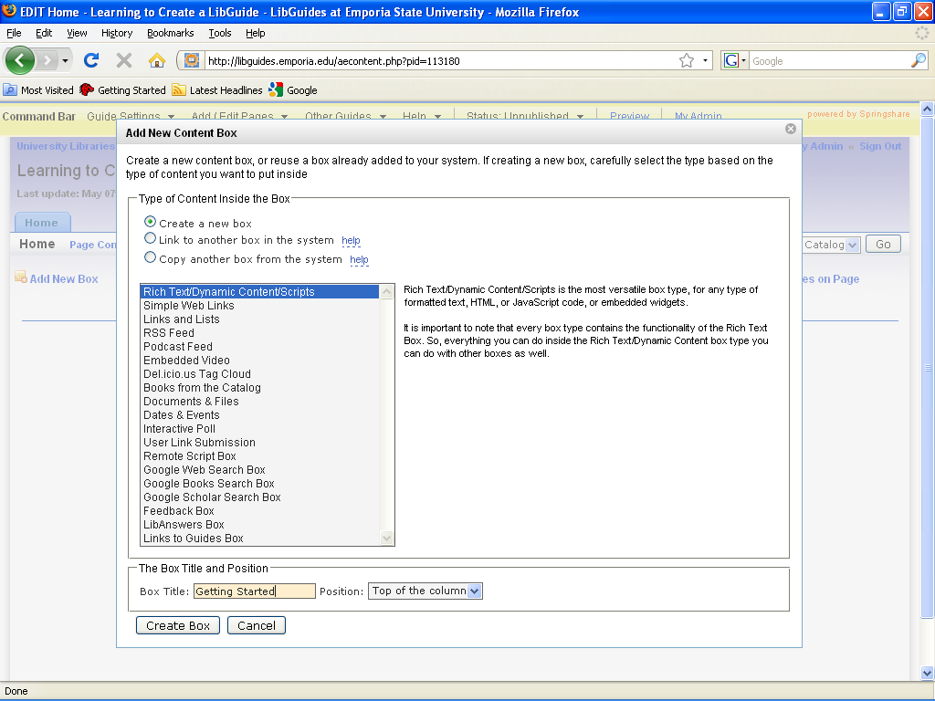

Slide 9
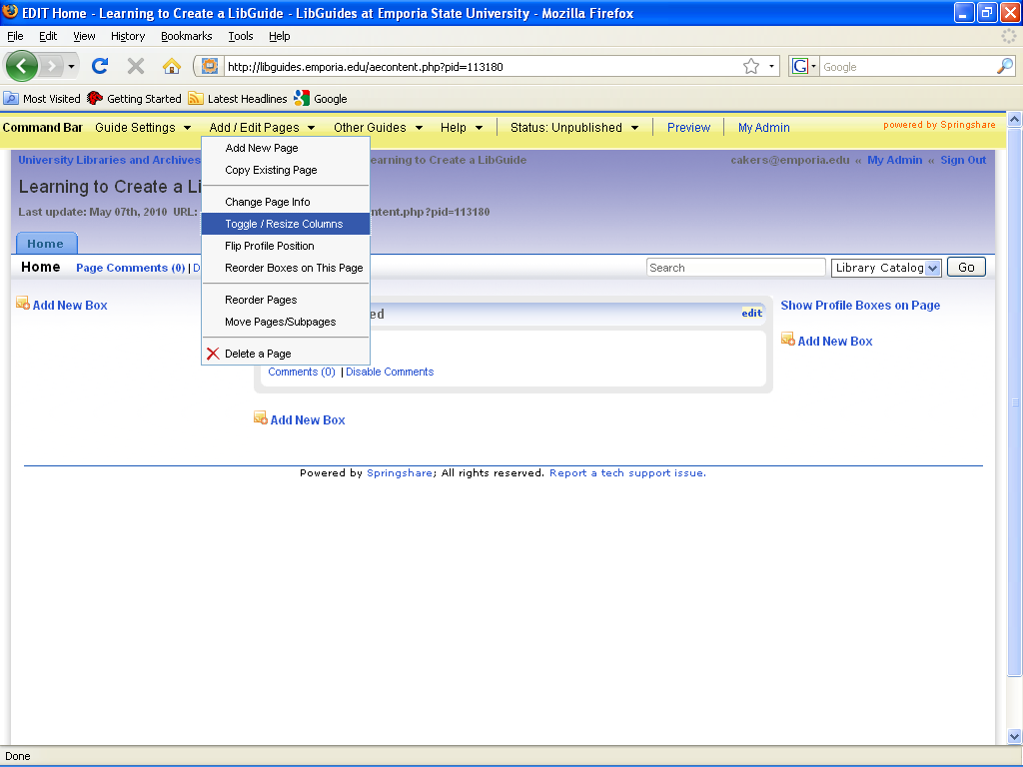

Slide 10
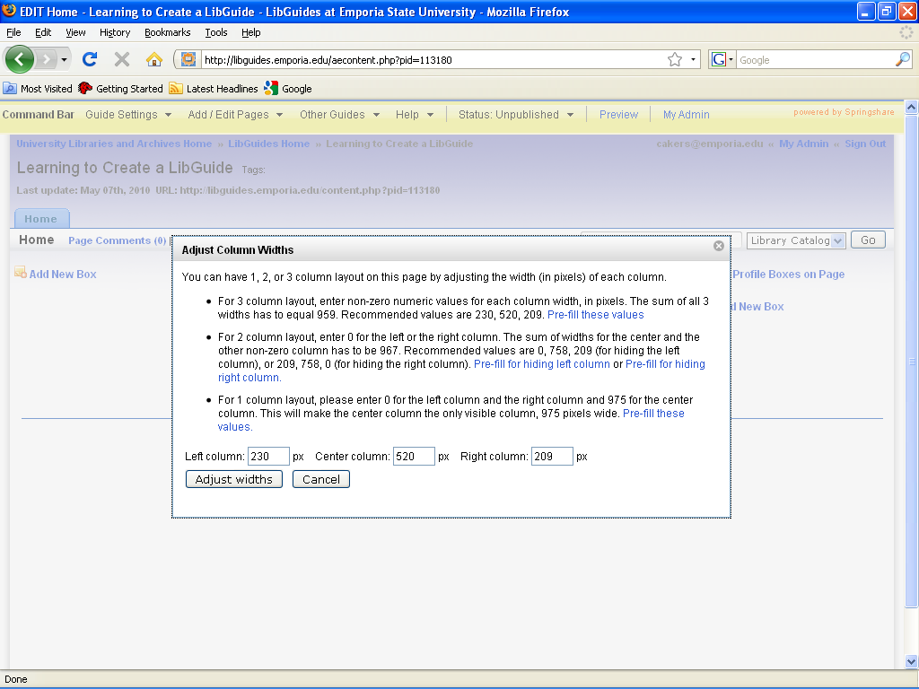

Slide 11
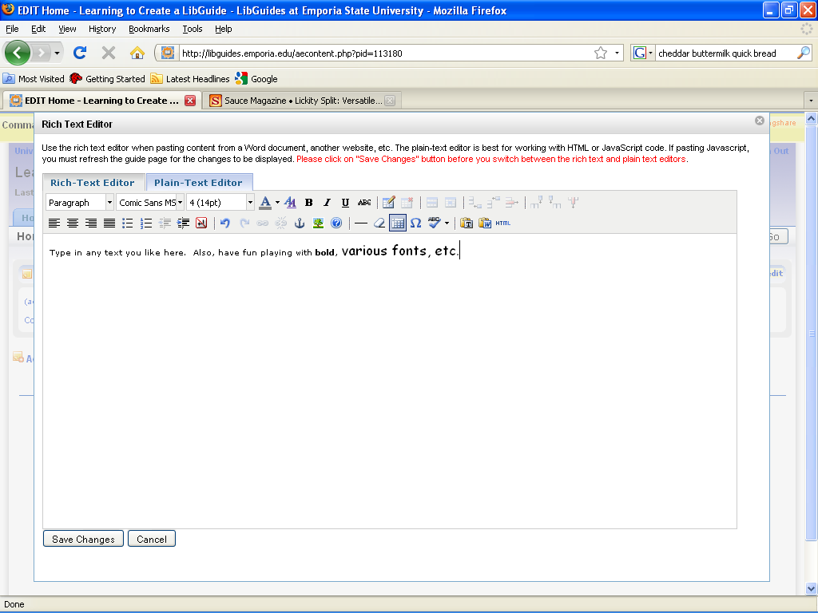

Slide 12
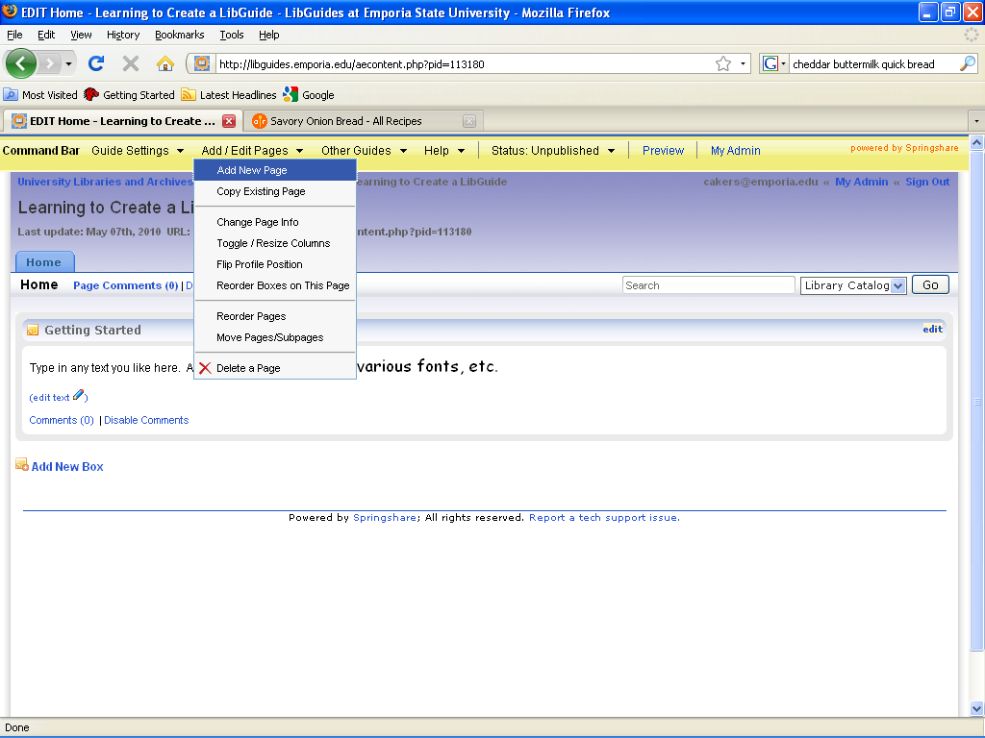

Slide 13
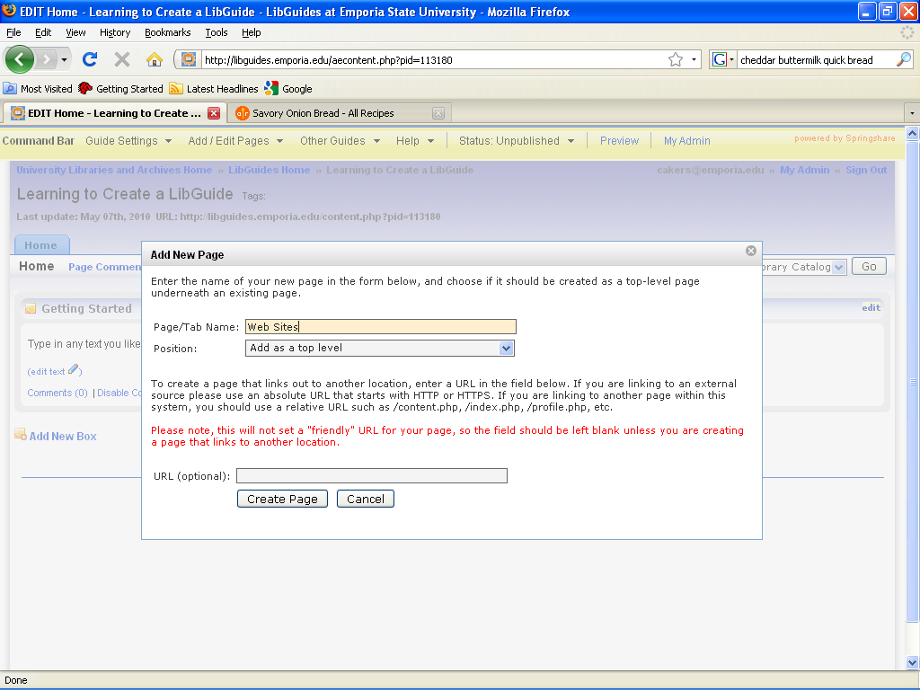

Slide 14
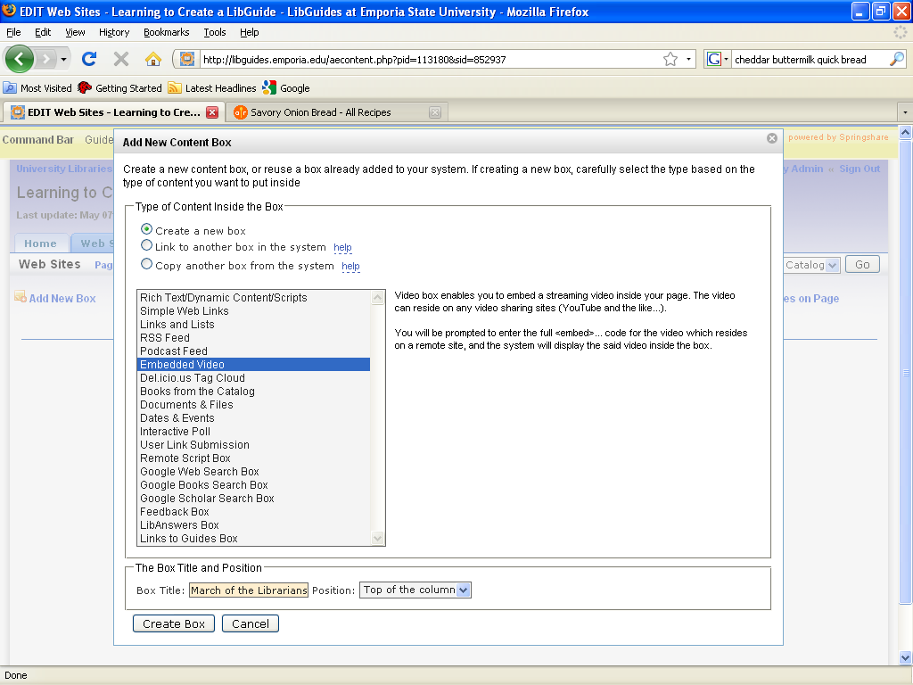

Slide 15
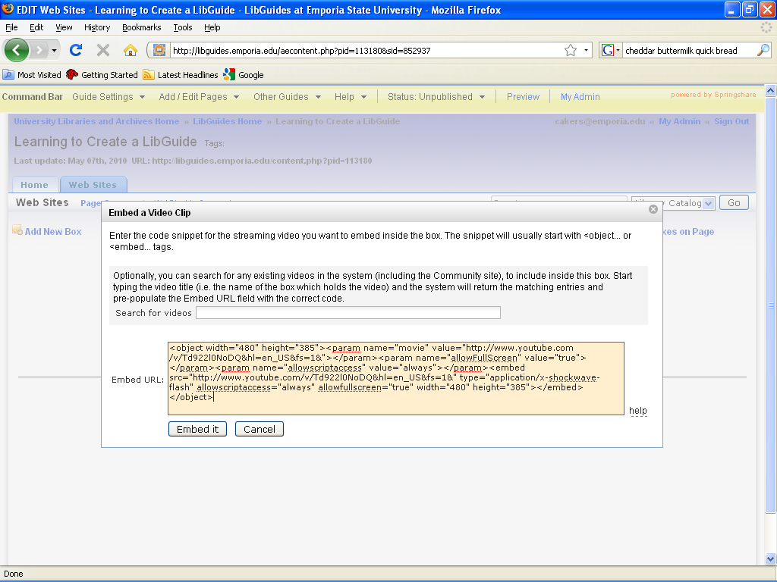

Slide 16
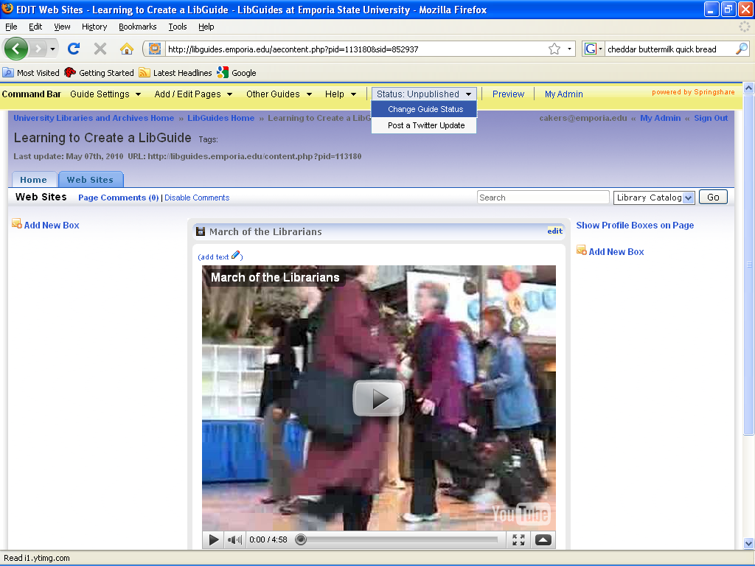

Slide 17
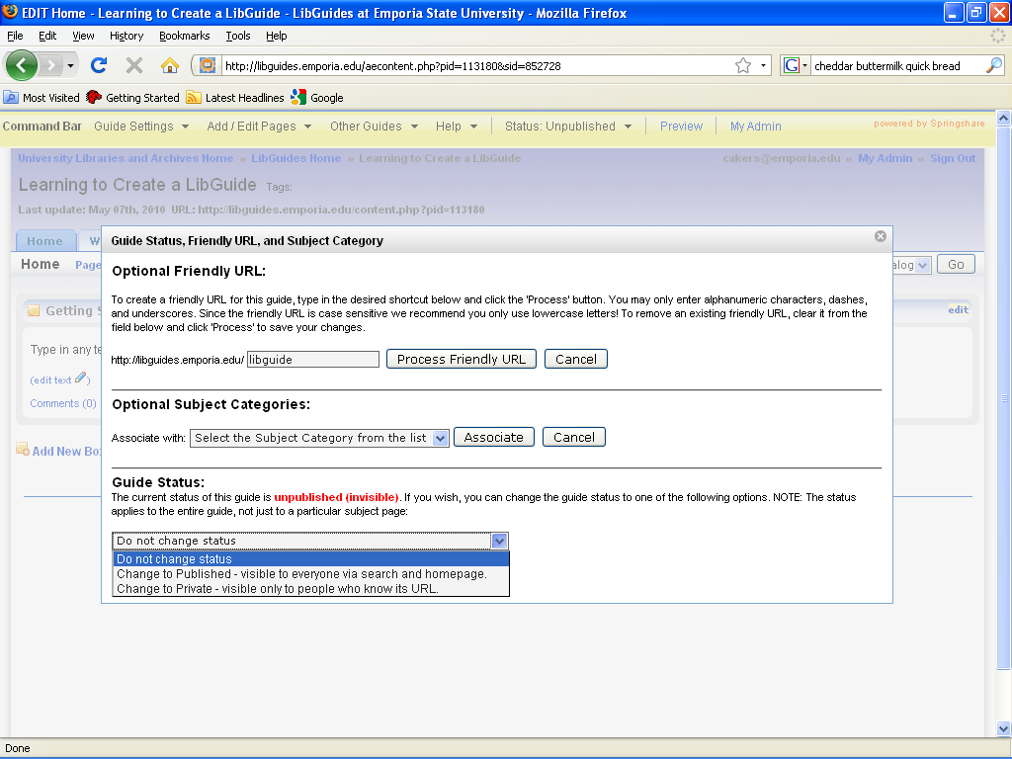

Slide 18
Other Fun Things to Customize Your Guide
Guide Settings: Change background colors of the pages; change boxes to round, rectangle, stripes
Guide Settings: Add editors to co-author your LibGuide (must be added in the system first by Administrator)

